Slide 1

Comparative Analysis of Workflow Scheduling Algorithms in Cloud Computing
MINOR PROJECT
Rahul Chauhan (2k14/CO/090)
Rahul Kumar (2k14/CO/091)
Rajat Verma (2K14/CO/093)
Under the supervision of :
Mr. Jasraj Meena
(COE Department, DTU)

Slide 2
List of Contents
Abstract
Introduction
System Model
ScaleStar Algorithm
BHEFT Algorithm
HBCS Algorithm
Datasets Used
MONTAGE
EPIGENOMICS
Graphical Analysis
Conclusion
References

Slide 3
Abstract
Cloud computing is a new terminology which is achieved by Distributed, Parallel and Grid computing. Clouds have progressed towards a service-oriented paradigm that enables a new way of service provisioning based on “pay-as-you-go” model. In such pay-as-you-go models, users are charged for services based on their usage and on the fulfillment of QoS constraints; execution time and cost are two common QoS requirements. Therefore, to produce effective scheduling maps, service pricing must be considered while optimizing execution performance. Efficient task scheduling mechanism can meet user’s requirements, and improve the resource utilization, thereby enhancing the overall performance of the cloud computing environment.
A lot of work has been done on this research topic. We have worked on algorithms that minimize the execution time while meeting the budget constraints set by the user. In this report we have conducted a comparative analysis of workflow scheduling algorithms. The algorithms considered for the purpose of comparison are ScaleStar, Budget-constrained Heterogeneous Earliest Finish Time (BHEFT) and Heterogeneous Budget Constrained Scheduling (HBCS).

Slide 4
Introduction
Cloud creates an infrastructure for enabling users to consume services transparently over a secure, shared, scalable, sustainable and standard worldwide network environment. In addition to this flexibility, Cloud infrastructure services provide the illusion of limitless resource allocation for most users.
Many complex applications in e-science and e-business can be modelled as workflows. A popular representation of a workflow application is the Directed Acyclic Graph (DAG), in which nodes represent individual application tasks, and the directed edges represent inter-task data dependencies.
In general, processing Time and Economic Cost are two typical constraints for MTW (Many-Task Workflow) execution on Cloud services. In this project, we compared budget conscious schedulers, which minimize MTW execution time within a certain budget. The MTW scheduling approach can be used by both end-users and CSPs. End users can use the approach to orchestrated Cloud services, whereas CSPs can outsource computing resources to meet customers’ service-level requirements.

Slide 5
System Model :
A typical workflow application can be represented by a Directed Acyclic Graph (DAG).
A DAG can be modelled by a tuple G(N,E), where N is the set of n nodes, each node ni ∈ N represents an application task, and E is the set of communication edges between tasks. The task computation times and communication times are modelled by assigning weights to nodes and edges respectively.
Each edge e(i, j) ∈ E represents a task-dependency constraint such that task ni should complete its execution before task nj can start.
In a given DAG, a task with no predecessors is called an entry task, and a task with no successors is called an exit task.

Slide 6
The schedule length of a DAG, also called Makespan, denotes the finish time of the last task in the scheduled DAG, and is defined by: makespan = max{AFT (nexit )} where AFT (nexit ) denotes the Actual Finish Time of the exit node.

Slide 7
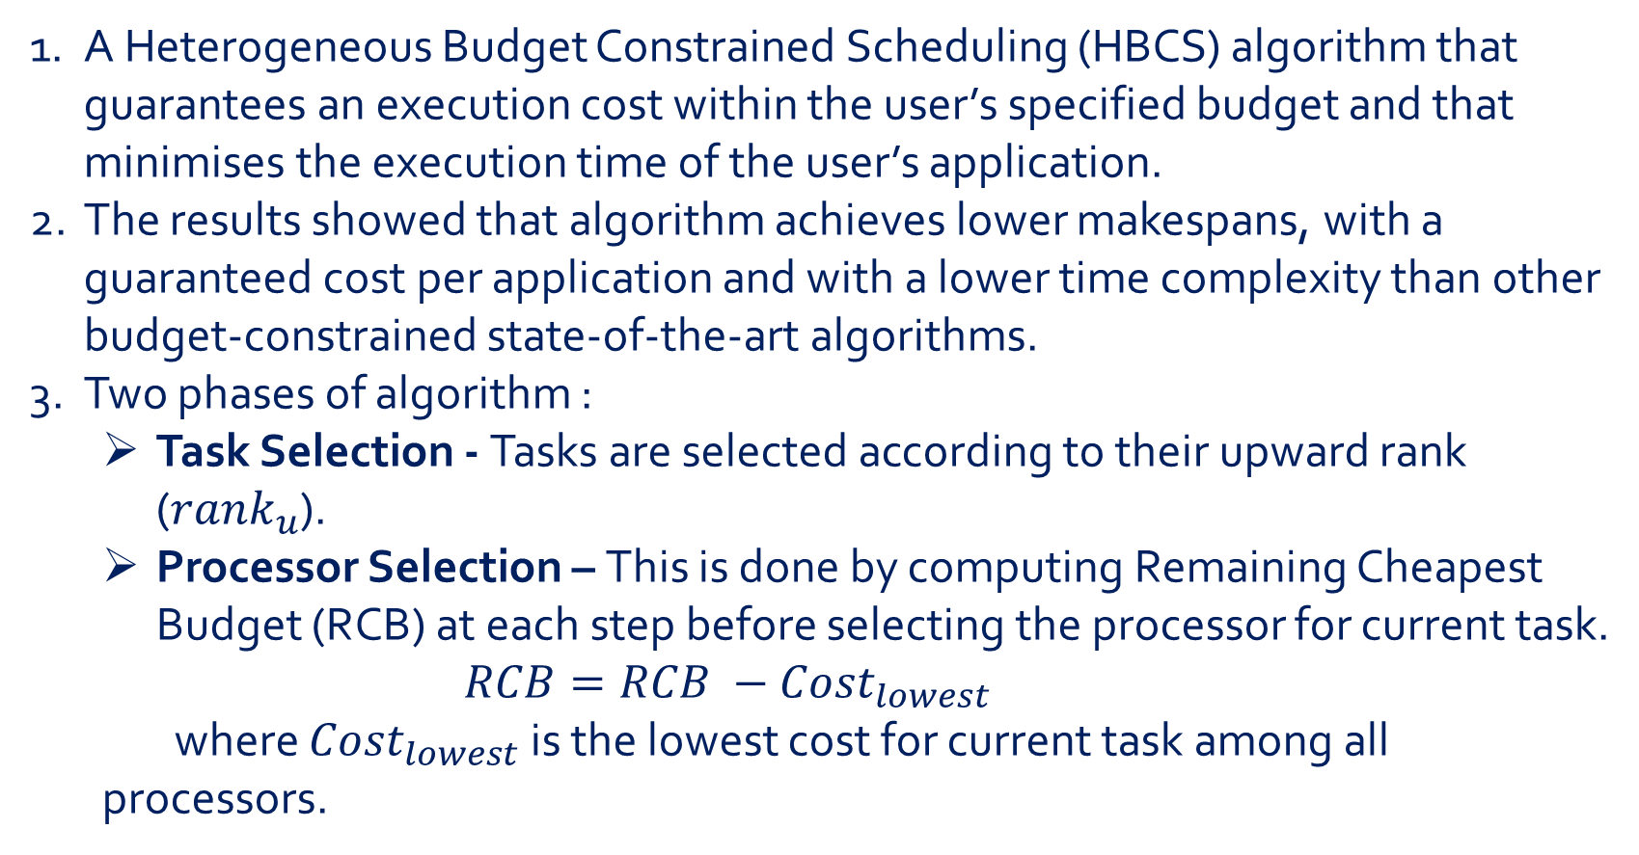
1. HBCS Algorithm
A Heterogeneous Budget Constrained Scheduling (HBCS) algorithm that guarantees an execution cost within the user’s specified budget and that minimises the execution time of the user’s application.
The results showed that algorithm achieves lower makespans, with a guaranteed cost per application and with a lower time complexity than other budget-constrained state-of-the-art algorithms.
Two phases of algorithm :
Task Selection - Tasks are selected according to their upward rank (${rank}_{u}$).
Processor Selection – This is done by computing Remaining Cheapest Budget (RCB) at each step before selecting the processor for current task.
$RCB=RCB −{Cost}_{lowest}$
where ${Cost}_{lowest}$ is the lowest cost for current task among all processors.

Slide 8
The HBCS Heuristic
Input: DAG and user defined BUDGET
1: Schedule DAG with HEFT and Cheapest algorithm
2: Set task priorities with rank_{u}
3: if HEFTcost < BUDGET
4: return Schedule Map assignment by HEFT
5: end if
6: RB = BUDGET and RCB = CheapestCost
7: while there is an unscheduled task do
8: ni = the next ready task with highest ranku value
9: Update the Remaining Cheapest Budget (RCB)
10: for all Processor pi ∈ P do
11: calculate FT(ni, pj ) and Cost (ni, pj )
12: end for
13: Compute CostCoeff
14: for all Processor pi ∈ P do
15: calculate worthiness(ni, pi)
16: end for
17: Psel = Processor pi with highest worthiness value
18: Assign Task ni to Processor Psel
19: Update the Remaining Budget (RB)
20: end while

Slide 9
2. ScaleStar Algorithm
ScaleStar assigns the selected task to a virtual machine with higher comparative advantage which effectively balances the execution time-and-monetary cost goals.
In addition, according to the actual charging model, an adjustment policy, refer to as DeSlack, is proposed to remove part of slack without adversely affecting the overall makespan and the total monetary cost.
Three phases of algorithm:
Task Priorities & Initial Assignment phase –

Slide 10
Task Re- assignment phase –
DeSlack policy –
To fill the slacks formed during the implementation of algorithm, thus decreasing Ideal time of VMs.

Slide 11
The ScaleStar Heuristic
Input: A DAG G = (N, E) with task execution time and communication. A set V of V VMs with cost of executing tasks and available Budget B.
Output: A DAG schedule S of G onto V.
1. Compute b-level of ∀ni ∈ N, sort N in decreasing order by b-level value
2. Build an array A[N][V ], where N is the number of tasks, V is the number of VMs
3. For ∀ni ∈ N and ∀vj ∈ V
Compute CA1 (ni, vj, v’) and CA1 (ni, v’ , vj) value with v’ use Eq.(9)
If CA1(ni, vj, v’ ) > CA1(ni, v’, vj), Replace v’ with vj , assign ni on v’
4. Compute makespanold and costold according to S
5. For ∀ni ∈ N and ∀vj ∈ V
If task ni is assigned to VM vj , A[i][j] = 0
Else
Compute makespannew assume ni is assigned to VM vj
Compute costnew assume ni is assigned to VM vj
A[i][j] = CA2(i, j)

Slide 12
The ScaleStar Heuristic (contd.)
6. Assign all the non-zero values of A to a set A
7. Sort A in increasing order by CA2 value
8. cost = the current total execution monetary cost
9. While (A is not empty)
If (cost > B), get the first element value A[i][j]
(and remove it) from A
If (cost ≤ B), get the last element value A[i][j]
(and remove it) from A
Reassign task i to VM j and calculate new monetary cost of schedule S
If (cost > B), invalidate previous reassignment for
task i to VM j
10. If (cost > B), use cheapest assignment for S
11. Call DeSlack policy

Slide 13
3. BHEFT Algorithm
BHEFT is based on the Heterogeneous Earliest Finish Time (HEFT) algorithm [4], which is a well-known list scheduling heuristic aiming at minimizing the overall execution time of a DAG application in a heterogeneous environment.
In BHEFT, the HEFT algorithm is extended in order to resolve the BDC(Budget Deadline Constraint)-planning problem and the new algorithm is called the Budget-constrained Heterogeneous Earliest Finish Time (BHEFT).
HEFT - The HEFT algorithm selects the task with the highest upward rank value at each step and assigns the selected task to the processor, which minimize the earliest finish time with an insertion-based approach.

Slide 14
The BHEFT heuristic
Input: DAG G with budget B and deadline D.
Output: A BDC-plan
1. Compute rank for all tasks.
2. Sort all tasks in a planning list in decreasing order of rank.
3. for k=0 to n do
4. select kth task from the planning list
5. compute the spare application budget for task k
6. compute the current task budget for task k
7. construct the set of affordable services for task k
8. for each service which can be used by task k do
9. compute the EFT of mapping k to the service using TSQ
10. endfor
11. select a service for task k according to defined selection rules.
12. endfor

Slide 15
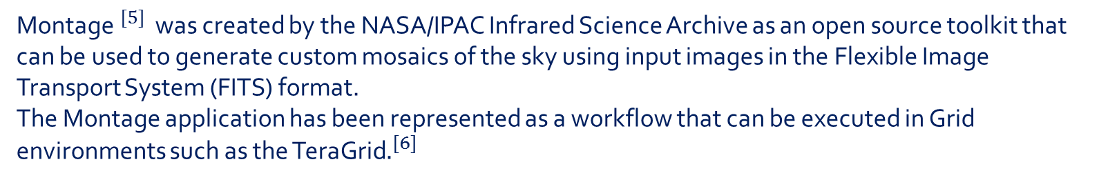
Datasets used
A.) Montage :
Montage$^{[5]}$ was created by the NASA/IPAC Infrared Science Archive as an open source toolkit that can be used to generate custom mosaics of the sky using input images in the Flexible Image Transport System (FITS) format.
The Montage application has been represented as a workflow that can be executed in Grid environments such as the TeraGrid$.^{[6]}$

Slide 16
B.) Epigenomics :
The USC Epigenome Center is currently involved in the mapping of the epigenetic state of human cells on a genome-wide scale. This workflow is being used by the Epigenome Center in the processing of production DNA methylation and histone modification data.

Slide 17
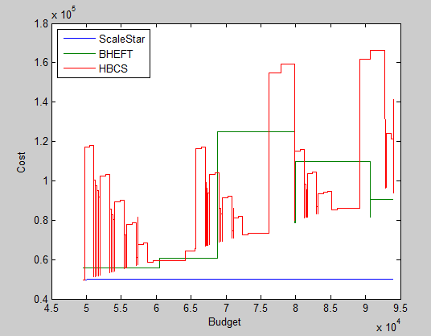
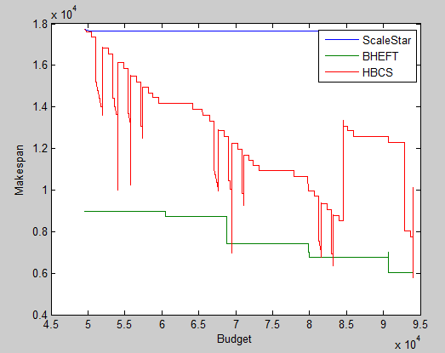
Graphical Analysis:
For Epigenomics -

Slide 18
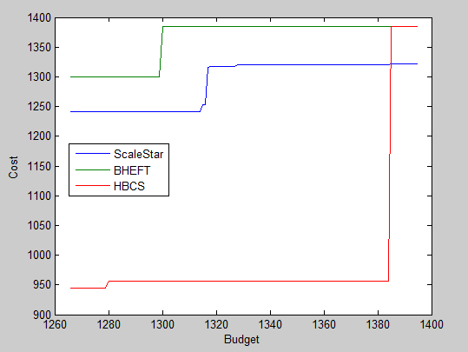
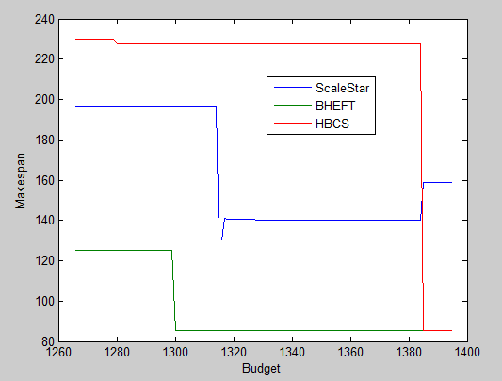
For Montage -

Slide 19
Conclusion
In this report we performed a comparative analysis of three well known algorithms namely ScaleStar, BHEFT and HBCS for workflow scheduling in the cloud environment. Our study makes an important contribution in timely and useful handling of scientific workflows on clouds. Our extensive simulation shows the comparison of the algorithms on two QoS parameters namely makespan and cost of scheduling.
According to our analysis we see that HBCS algorithm provides the maximum variation in cost and makespan when the budget is varied. Whereas BHEFT produces a moderate variation in results and ScaleStar produces almost no variation in results. For the epigenomics dataset, BHEFT produces schedules that have lowest makespans. Also in case of montage dataset we see that BHEFT produces schedules that have lowest makespans. Hence we can say that BHEFT outperforms the other two scheduling algorithms.

Slide 20
References
Lingfang Zeng, Bhardway Veeravalli “ScaleStar: Budget Conscious Scheduling Precedence-Constrained Many-task Workflow Applications in Cloud” .
Wei Zheng, Rizos Sakellariou “Budget-Deadline Constrained Workflow Planning for Admission Control”.
Hamid Arabnejad, Jorge G. Barbosa “A Budget Constrained Scheduling Algorithm for Workflow Applications”
Topcuoglu, H., Hariri, S., Wu, M. “Performance effective and low-complexity task scheduling for heterogeneous computing.”
G. B. Berriman, E. Deelman, J. Good, J. Jacob, D. S. Katz C. Kesselman, A. Laity, T. A. Prince, G. Singh, and M. Su, “Montage: A grid enabled engine for delivering custom science-grade mosaics on demand,” in SPIE, 2004.
“Montage: An astronomical image engine.” [Online]. Available: http://montage.ipac.caltech.edu .
Bittencourt, L.F., Madeira, E.R.M.: Hcoc: a cost optimization algorithm for workflow scheduling in hybrid clouds. J. Internet Serv. Appl. 2(3), 207–227 (2011).
Prodan, R., Wieczorek, M.: Bi-criteria scheduling of scientific grid workflows. IEEE Trans. Autom. Sci. Eng. 7(2), 364–376 (2010)

Slide 21
Thank you!!!

